Slide 1
Computer Engineering
Fun
Logics
(Engineered in Linux)

Slide 2
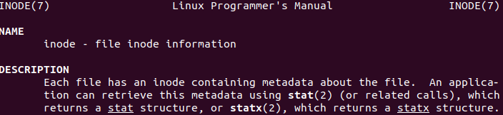
iNode (Yes, its not typo.Don’t read as iPhone)
inode
Surprisingly inode term date backs to history in 19XX

Slide 3
A file which never grows its size on physical disk
/dev/null
No matter how much you write into this file, it consumes it all and surprisingly never grows file size and hence disk space never wasted.
Application:
Whenever a certain server/application program is generating output which you just want to ignore, redirect here. But the question is why would you want to ignore output? Funny isn’t it?

Slide 4

Something is both parent and child for itself
File system root / in Linux directory structure
. refers to current directory while .. refers to parent directory
Root (/) . and .. both are itself. Note the inode number 2.
Applications: Chicken and Egg situation This actually made possible to define root itself. Directories can have sub-directories which themselves are directories as such. But recursion base case is interesting here. Also then who is inode number 1? Lol.

Slide 5


Functions: always succeeds, returns twice , never returns
umask
fork()
exit()

Slide 6
A data structure as well as a file ..
/proc
Process information pseudo-filesystem
This provides an interface to kernel data structures and mounted at a directory /proc
Application: Read data structures of a program (in this case OS Kernel) as you are reading from a file

Slide 7
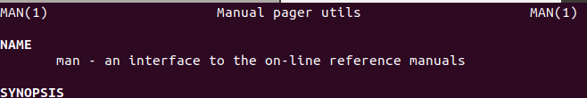
man man : Things which teach also need to be learnt!
man command stands for user manual in Linux of commands/apis and more
Interestingly man man shows manual of itself too.
Application: If something helps to learn about other things people still need to learn that. How about teacher teaches about itself too!

Slide 8
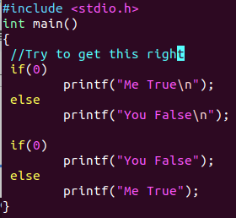

0 is FALSE and 0 is SUCCESS too
EXIT_SUCCESS
echo $? No no no ... don’t think success is false.
Success is one, failures can be many.

Slide 9

Zombies exist and God too ... Even in computer world!
man ps
Init
Then who manages init?

Slide 10

To support/Support to those who forget who they are :
who
whoami
Application:
When working on multiple computers at once and performing many tasks via different roles it comes handy to remind yourself who you are and what you should be doing and what not. Ha ha ...

Slide 11


Everything is of importance and wants to identify by same
Administrator/Super User is known as root
Root is / beginning of file system
Root is also name of a user
Root is also a directory
Am I missing anything ???

Slide 12

Immunization is everywhere
nohup
No hang up

Slide 13


One man army is possible
id (uid,gid) ,adduser

Slide 14
Thanks
If you have made through HERE
You have learnt a few of the Linux and Computer Engineering Concepts actually.
Happy Learning !!!
By the way there is something in Linux called HERE DOCUMENT. May wanna learn... have fun.

